Slide 1
Chapter 3
The Social Self

Slide 2

Sense of Self
ABCs of the self:
  Affect (emotion)
  Behavior
  Cognition
Product of consciousness, but heavily influenced by social factors

Slide 3
The Self-Concept
Self-concept
  The sum total of an individual’s beliefs about their own personal attributes.
  Includes roles, social connections, beliefs/values, etc.
  Everything that makes up one’s identity!
Self-schema
  A belief people hold about themselves that guides the processing of self-relevant information.
  Can have multiple! (example: Identifying w/ 2 cultures)

Slide 4
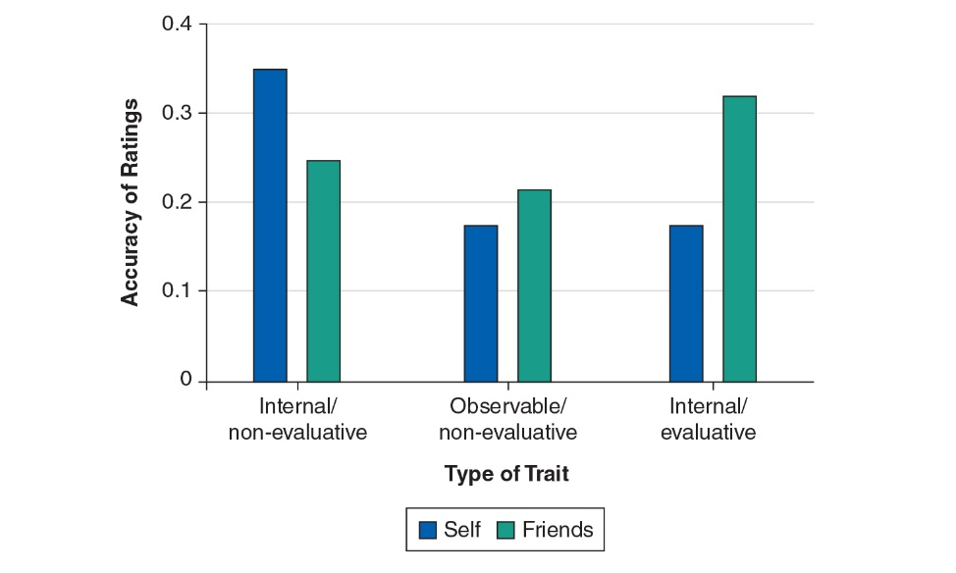
Self-other Knowledge Asymmetry (SOKA)
Notes:
Vazire (2010)
Non-eval are neutral, eval are valenced
1) Anxiety levels, 2) talkativeness, eye contact 3) self-esteem, competence
Participants rated themselves and were rated by friends on personality traits for which they took various objective tests. As shown, self-ratings were more accurate for internal/nonevaluative traits (left), and self-ratings and friend ratings were equally accurate for observable/nonevaluative traits (center). Interestingly, however, friend ratings were more accurate for internal/evaluative traits. Supporting SOKA, this pattern shows that “know thyself” requires a combination of information and objectivity.

Slide 5
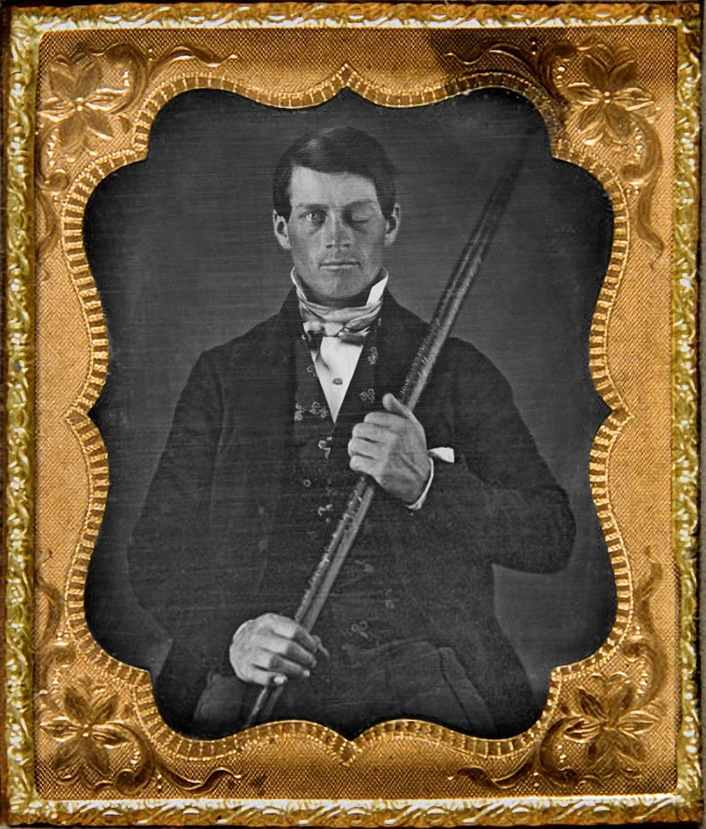
Is the Self Specially Represented in the Brain?
Self-concept is tied to memory and executive functioning
Self can be transformed or completely destroyed by damage to the brain and nervous system.
  Concepts related to the self (e.g., personality) also experience these changes!
    Example: Phineas Gage

Slide 6
Self-awareness
Theory of mind: Understanding that one’s own thoughts and feelings are separate from others
General understanding that you are a unique individual

Slide 7
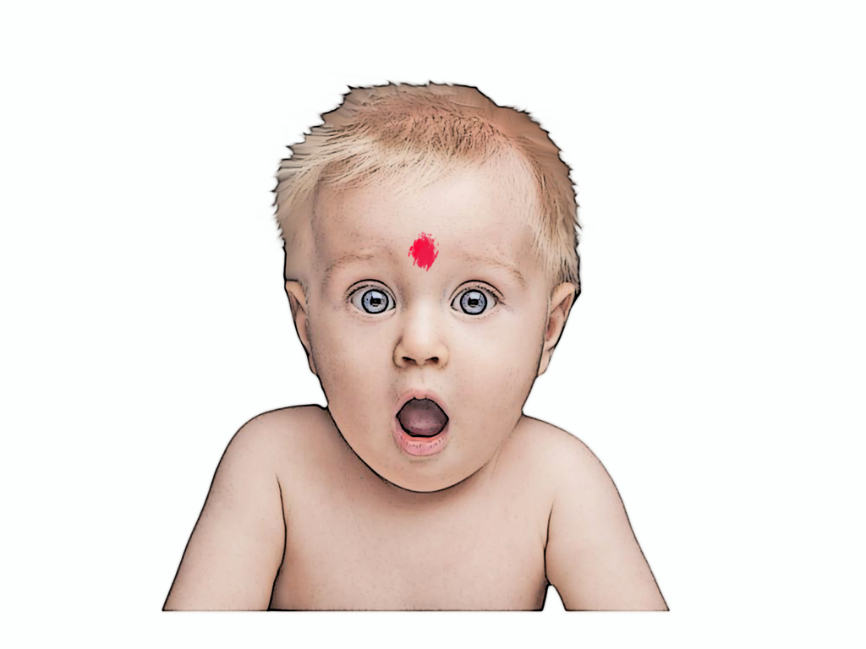
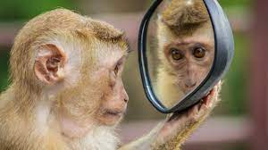
Assessing Self-Awareness in Animals
Do individuals recognize themselves?
  Mirror test used with babies and animals
A mark is placed on the baby/animal’s face
  Attempts to touch or the remove the mark are taken as signs that they recognize themselves in the mirror

Slide 8
Assessing Self-Awareness in Animals
Mirror Test w/ orangutans: https://www.youtube.com/watch?v=Okmkn30D0NU

Slide 9
When does self-awareness begin?
Humans: 1 year-olds sometimes notice the mark in the mirror; all humans easily pass test by the age of 3
Animals: Mostly great apes (chimpanzees, orangutans) seemed capable of self-recognition.
  Asian elephants?
  Dolphins?
Seems “the-self” is mostly (but not entirely!) a human concept?

Slide 10
Learning About One’s Self
Introspection: Achieving insight into their own beliefs, attitudes, emotions, desires, personalities, and motivations?
  “Inward thinking”
  Problems?
  Most people overestimate the positives when
  self-assessing.

Slide 11
The Self-Concept and Memory
Autobiographical Memories
  Recollections of impactful events
  Shape self-concept
Recent recall vs. Distant Recall
  Exceptions: Older adults
  Transitional “Firsts”
Flashbulb memories: Enduring, detailed recollections
Notes:
LO 3-1 Describe the internal and external factors that influence a person’s self-concept.
The Self-Concept
Autobiographical Memories
Autobiographical memories are the recollections of the sequences of events that have touched one’s life.
Memories shape the self-concept.
When people are prompted to recall their own experiences, they typically report more events from the recent past than from the distant past.
Two exceptions to this rule:
1) Older adults tend to retrieve a large number of personal memories from their adolescence and early adult years.
2) People tend to remember transitional “firsts”—like the first-time setting foot on college campus, or the day one met a close friend.
One might expect in years to come that people across the world will exhibit a COVID bump—an increase in autobiographical memories that accompanied the traumatic onset of the Pandemic.
Flashbulb memories: enduring, detailed, high-resolution recollections.
People tend to distort the past in ways that inflate their own sense of importance and achievement.
Harry Bahrick and others (1996) had college students try to recall all of their high school grades and then checked their reports against the actual transcripts. Overall, the majority of grades were recalled correctly. But most of the errors in memory were grade inflations—and most of these were made when the actual grades were low.

Slide 12
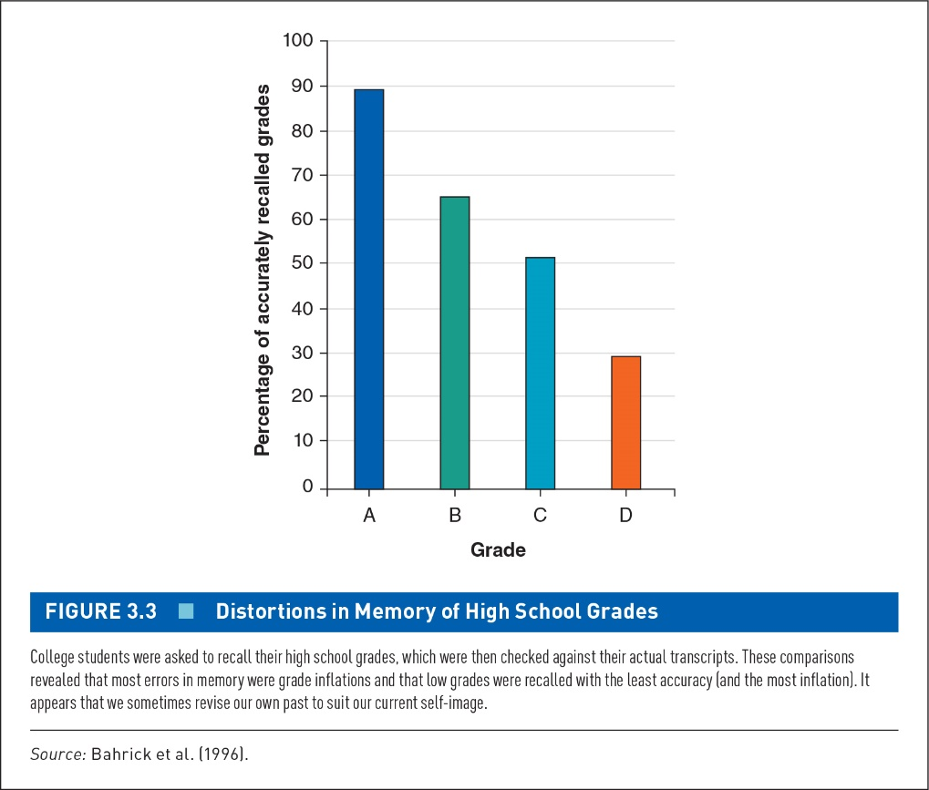
Bahrick et al. (1996)
Notes:
How accurate are self-memories?
Source: Bahrick et al. (1996).
College students were asked to recall their high school grades, which were then checked against their actual transcripts. These comparisons revealed that most errors in memory were grade inflations and that low grades were recalled with the least accuracy (and the most inflation). It appears that we sometimes revise our own past to suit our current self-image.

Slide 13
Learning About One’s Self
Affective Forecasting: The process of predicting how one would feel in response to future emotional events.
Possible reasons
  Underestimating psychological coping mechanisms
  Focusing on a single event and neglecting the effects of other life experiences
To become more accurate, think more broadly about all the events that impact us.

Slide 14
Self-Perceptions of Motivation
Extrinsic motivation originates in factors outside the person.
Intrinsic motivation originates in factors within a person.
Overjustification effect
  The tendency for intrinsic motivation to diminish for activities that have become associated with reward or other extrinsic factors.

Slide 15
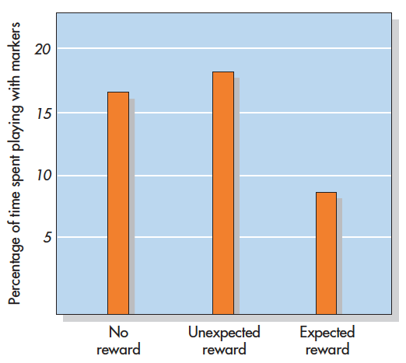
Paradoxical Effects of Reward on Intrinsic Motivation (Lepper et al., 1973)
Notes:
Figure 3.2 Paradoxical Effects of Reward on Intrinsic Motivation In this study, an expected reward undermined children’s intrinsic motivation to play with felt-tipped markers. Children who received an unexpected reward or no reward did not lose interest.
Based on Lepper et al., 1973.

Slide 16
Influences of Other People
We often describe ourselves by comparing ourselves to others.
  Social comparison theory (Festinger)
When people are uncertain of their abilities or opinions, they evaluate themselves by comparison to similar others.
We learn by modeling! (By nature, we’re social creatures!)

Slide 17
Two-Factor Theory of Emotion
Social interaction is also important for interpreting emotion:
Two-factor theory of emotion: The theory that the experience of emotion is based on two factors:
  The experience of symptoms of physiological arousal
  A cognitive interpretation that explains the source of the arousal
Other people’s reactions sometimes help us interpret our own arousal.

Slide 18
Culture and the Self-Concept
  Culture Concept:
    Psychology we study today has a western cultural bias which influences people’s definition of social structure and coping strategies.
    Western countries believe in an investigative thinking style, in which objects are largely perceived independently from their context.
    Eastern countries believe in holistic thinking style, in which object and context are perceived to be interconnected.
    Can potentially bias how we study the self!

Slide 19
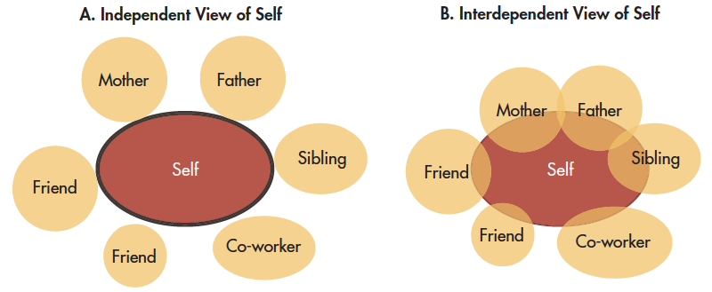
Cultural Conceptions of Self
Individualism
Collectivism
Notes:
Figure 3.5 Cultural Conceptions of Self As depicted here, different cultures foster different conceptions of the self. Many Westerners have an independent view of the self as an entity that is distinct, autonomous, and self-contained. Yet many Asians, Africans, and Latin Americans hold an interdependent view of the self that encompasses others in a larger social network.
Based on Marcus, and Kitayama, 1991

Slide 20
Culture and the Self-Concept
Self-concept and cultural
Example:
  American parents try to raise their children to be independent, self-reliant, and assertive.
  Japanese children are raised to fit into their groups and community.

Slide 21
Cultural Influences on the Self
North America and Europe
  Independent view of the self
  View self as distinct, autonomous, self contained, and endowed with unique dispositions
  Describe themselves more in terms of personal traits
  See themselves as less similar to other people
  People in individualistic culture strive for personal achievement.

Slide 22
Cultural Influences on the Self
Asia, Africa, Latin America
  Interdependent view of self
  View self as part of larger network of social connections
  Describe themselves in terms of group affiliations
  Derive satisfaction from the status of a valued group
  More accepting that apparent opposites can coexist within a single person (dialecticism)

Slide 23
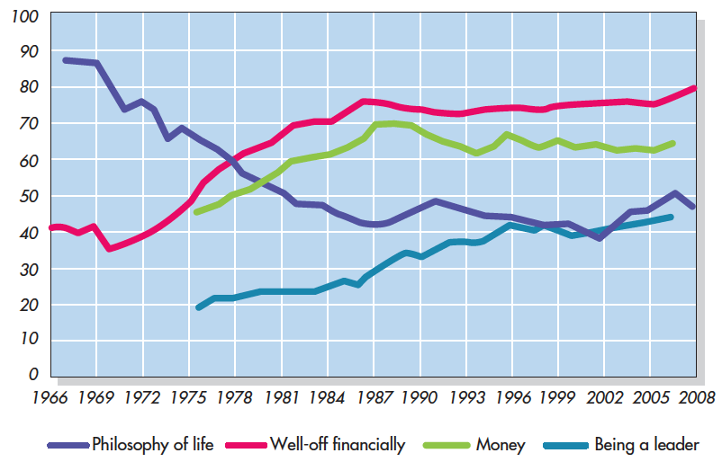
Generational Differences in American Cultural Orientation
Notes:
Figure 3.7 Generational Differences in American Cultural Orientation Over the years, surveys have been administered to millions of Americans who grew up in the 1940s–1950s (“baby boomers”), 1960s–1970s (“GenX’ers”), and 1980s–1990s (“Millennials”). From the responses of high school and college students from 1966 to 2009, it seems that compared to boomers, later generations were more focused on money, fame, and self-image, and less concerned with affiliation, community, and civic engagement. These changes suggest that American culture is more individualistic today than it was a half century ago.
Based on Twenge et a., 2012.
Philosophy of life: a set of values and beliefs that guide how someone lives their life.

Slide 24
Social Class as a Cultural Influence
Social class: Categorizes individuals based on SES status
In Western countries, people with more income, education, and status tend to have more opportunities to exhibit individualism.

Slide 25

Self-Esteem
An evaluative component of the self.
Made up of many self-schemas.
  Some parts they judge more favorably or see more clearly or as more important than other parts.
  Self-esteem is multi-faceted: High self-esteem for one aspect, but low for another
Not always stable over time!

Slide 26
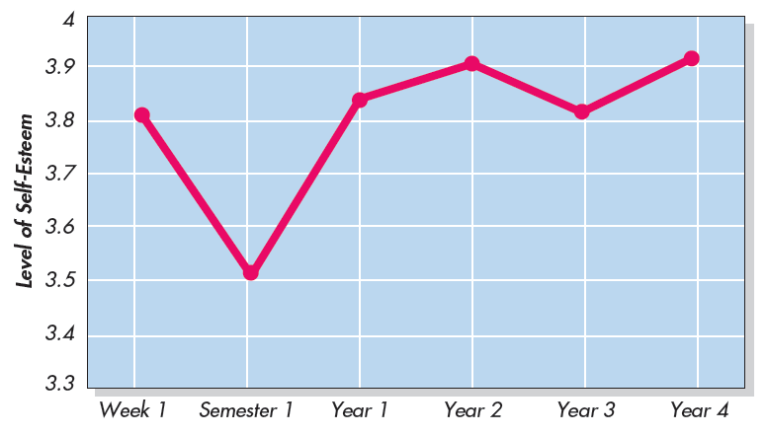
Self-Esteem Over the Course of a College Career
Notes:
Figure 3.8 Self-Esteem Over the Course of a College Career In this longitudinal study of college students who were repeatedly tested, self-esteem
dropped sharply during their first semester but then recovered and increased into their senior year. Chung et al., 2014.

Slide 27
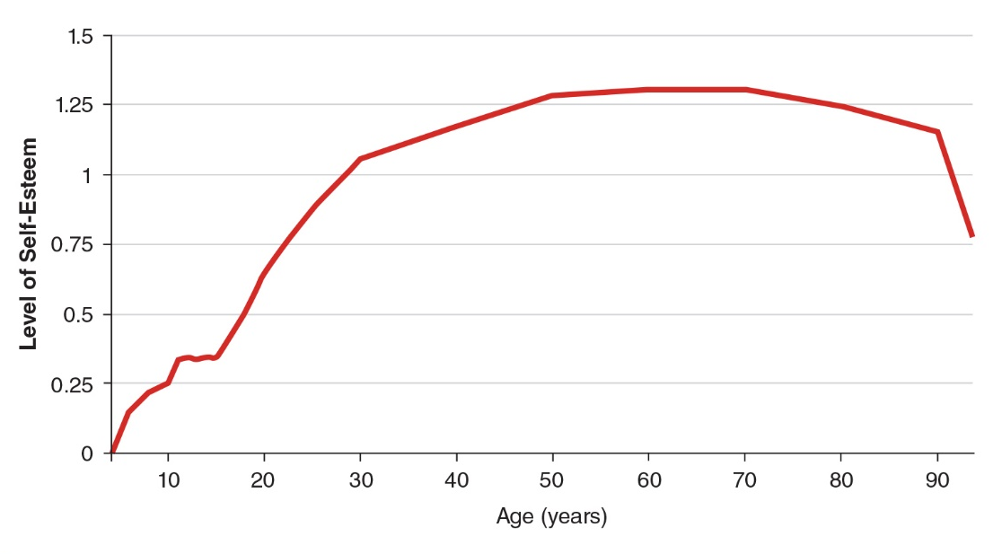
Self-Esteem Over the lifespan (1)
Notes:
Figure 3.8 Self-Esteem Over the Course of a College Career In this longitudinal study of college students who were repeatedly tested, self-esteem
dropped sharply during their first semester but then recovered and increased into their senior year. Chung et al., 2014.

Slide 28
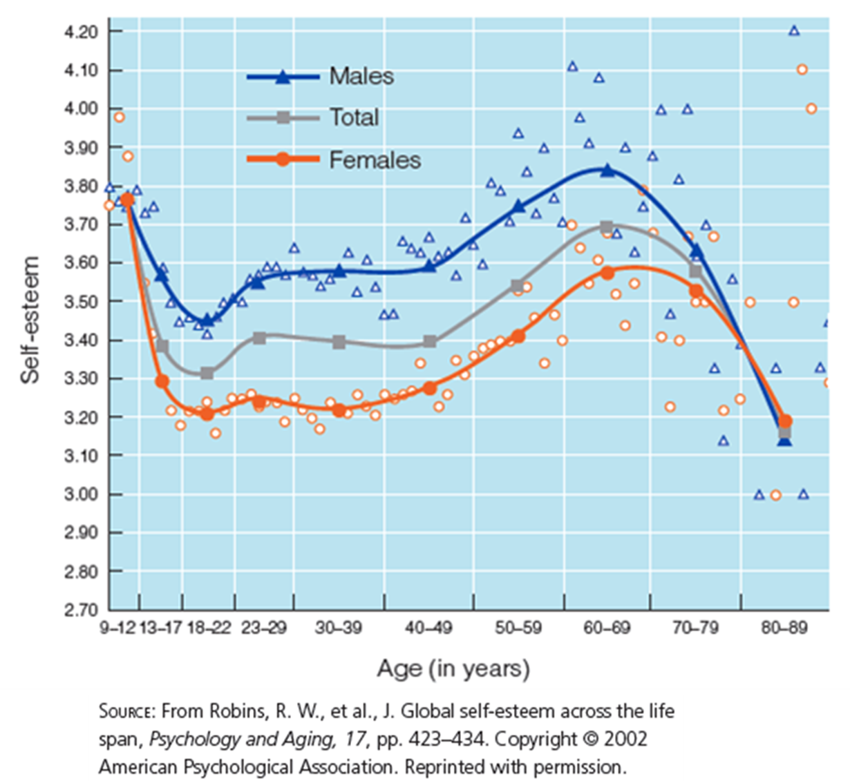
Self-Esteem over the Life-Span (2)
Notes:
Figure 11.3 Self-esteem dips in early adolescence and rises during the adult years
hierometer theory (Mahadevan et al. 2016) also postulates that self- esteem rises and falls in tandem with higher or lower social status.

Slide 29

The Need for Self-Esteem
Sociometer theory (Leary and Baumeister)
  People are inherently social animals.
  The desire for self-esteem is driven by a more primitive need to connect with others.
Terror management theory (Greenberg, Solomon, and Pyszczynski)
  Humans are biologically programmed for life and self-preservation.
  We are conscious of—and terrified by—the inevitability of our own death.
  Self-esteem protects us from these concerns
Hierometer theory (Mahadevan et al. 2016)
  self- esteem rises and falls in tandem with higher or lower social status.

Slide 30
Self-Discrepancy Theory
Actual self versus ought self versus ideal self
  Actual: Current self-concept; describe the kind of person you think you are
  Ought: Traits that would enable you to meet your sense of duty, obligation, and responsibility
  Ideal: Traits that describe the kind of person you would like to be

Slide 31
Self-Discrepancy Theory
What happens if actual self does not match ideal self?
Self-esteem is lowered!
The greater the disparity, the lower self-esteem gets!

Slide 32
The Self-Awareness “Trap”
Self-awareness theory
  Self-focused attention leads people to notice self-discrepancies.
  Motivates either an escape from self-awareness or a change in behavior.
  Not coping == cognitive dissonance

Slide 33
Trait Self-Consciousness (1)
Private self-consciousness
  A personality characteristic of individuals who are introspective, often attending to their own inner states
Public self-consciousness
  A personality characteristic of individuals who focus on themselves as social objects, as seen by others

Slide 34
Trait Self-Consciousness (2)
Source: Fenigstein et al. (1975).
Items That Measure Private Self-Consciousness
I’m always trying to figure myself out. I’m constantly examining my motives. I’m often the subject of my fantasies. I’m alert to changes in my mood. I’m aware of the way my mind works when I work on a problem.
Items That Measure Public Self-Consciousness
I’m concerned about what other people think of me. I’m self-conscious about the way I look. I’m concerned about the way I present myself. I usually worry about making a good impression. One of the last things I do before leaving my house is look in the mirror.
Notes:
LO 3-2 Explain how self-esteem can fluctuate through self-awareness, self-regulation, and self-enhancement.
These sample items appear in the Self-Consciousness Scale. How many of these statements indicating private or public self-consciousness would you use to describe yourself?

Slide 35
Self-Regulation and Its Limits
Self-regulation: The process by which people control their thoughts, feelings, or behavior in order to achieve a personal or social goal
Self-regulation fatigue: Sees self-control as a limited inner resource that can temporarily be depleted by usage (Muraven and Baumeister)
Psychological factors can counteract self-regulation fatigue.

Slide 36
Ironic Mental Processes
“Choking”
  A paradoxical type of failure caused by trying too hard and thinking too much
Ironic processes
  The harder you try to inhibit a thought, feeling, or behavior, the less likely you are to succeed

Slide 37
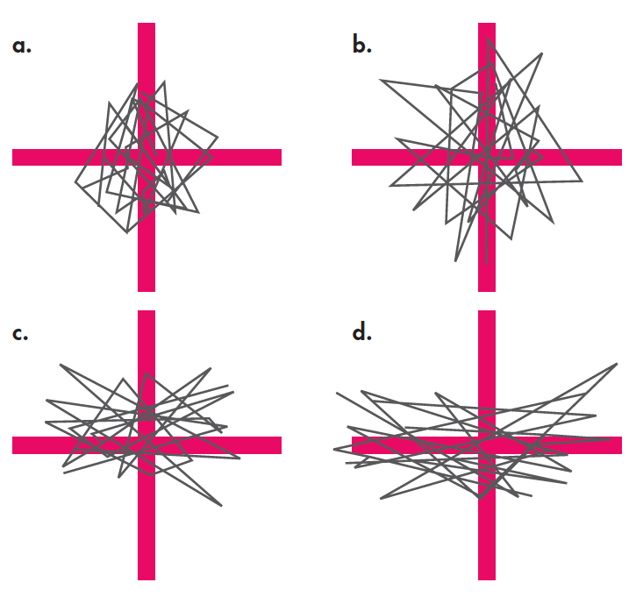
Ironic Effects of Mental Control
“Keep it steady”
“Prevent Movement”
Notes:
Figure 3.15 Ironic Effects of Mental Control In this study, participants tried to hold a pendulum motionless over a grid. As illustrated in the tracings shown here, they were better at the task when simply instructed to keep the pendulum steady (a) than when specifically told to prevent horizontal movement (c). Among participants who were mentally distracted during the task, this ironic effect was even greater (b and d).
Wegner et al., 1998.

Slide 38
Culture and Self-Esteem
All people have a need for positive self-regard
  Individualists tend to use self-enhancement tactics
  Collectivists tend to maintain face in order to fit in
Focus on the self vs. one’s place in society

Slide 39
Self-Presentation (1)
Self-presentation is strategic!
  Effort to shape others’ impressions
  Gain influence, power, sympathy, approval
  Variation between people, situations.
Notes:
LO 3-3 Analyze why and how people adjust how they present themselves to others.
Self-Presentation
Self-presentation: strategies people use to shape what others think of them.
Strategic Self-Presentation
Strategic self-presentation consists of efforts to shape others’ impressions in specific ways in order to gain influence, power, sympathy, or approval.
Examples: personal ads, online dating sites, political campaign promises, and defendants’ appeals to the jury.
Goals include the desire to be seen as likable, competent, moral, dangerous, or helpless.
The specific identities that people try to present may vary from one person and situation to another.
Two common strategic self-presentation goals:
Ingratiation describes acts that are motivated by the desire to “get along” with others and be liked.
Self-promotion describes acts that are motivated by a desire to “get ahead” and gain respect for one’s competence.
Reference Table 3.2 Strategic Self-Presentation in a job interview.

Slide 40
Strategic Self-Presentation in the Employment Interview
Self-Promotion
I played up the value of positive events that I took credit for.
I described my skills and abilities in an attractive way.
I took charge during the interview to get my main points across.
I took credit for positive events even if I was not solely responsible.
I made positive events I was responsible for appear better than they actually were.
Notes:
Table 3.2 Strategic Self-Presentation in the Employment Interview In studies of the influence tactics that job applicants report using in employment interviews, the following uses of ingratiation and self promotion were commonly reported.
Higgins and Judge, 2004; Stevens and Kristof, 1995.

Slide 41
Self-Presentation (2)
The tendency to regulate one’s own behavior to meet the demands of social situations
High self-monitors: Appear to have a repertoire of selves from which to draw
  They regard themselves as pragmatic, flexible, and adaptive.
Low self-monitors: Self-verifiers by nature, appearing less concerned about the social acceptability of their behavior
  See themselves as principled and forthright
  Less likely to change to “fit-in”

Slide 42
Self-Presentation (3)
Source: Snyder & Gangstad (1986).
Self-Monitoring Scale
1. I find it hard to imitate the behavior of other people.
2. At parties and social gatherings, I do not attempt to do or say things that others will like.
3. I can only argue for ideas that I already believe.
4. I can make impromptu speeches even on topics about which I have almost no information.
5. I guess I put on a show to impress or entertain others.
6. I would probably make a good actor.
7. In a group of people, I am rarely the center of attention.
8. In different situations and with different people, I often act like very different persons.
9. I am not particularly good at making other people like me.
Notes:
LO 3-3 Analyze why and how people adjust how they present themselves to others.
Are you a high or low self-monitor? For each statement, answer True or False. When you are done, give yourself 1 point if you answered True to items 4, 5, 6, 8, 10, 12, 17, and 18. Then give yourself 1 point if you answered False to items 1, 2, 3, 7, 9, 11, 13, 14, 15, and 16. Count your total number of points. This total represents your Self-Monitoring Score. Among North American college students, the average score is about 10 or 11.

Slide 43
Self-Presentation (4)
Table 3.3: Self-Monitoring Scale (cont’d)
10. I’m not always the person I appear to be.
11. I would not change my opinions (or the way I do things) in order to please someone or win their favor.
12. I have considered being an entertainer.
13. I have never been good at games like charades or improvisational acting.
14. I have trouble changing my behavior to suit different people and different situations.
15. At a party, I let others keep the jokes and stories going.
16. I feel a bit awkward in company and do not show up quite as well as I should.
17. I can look anyone in the eye and tell a lie with a straight face (if for a right end).
18. I may deceive people by being friendly when I really dislike them.
Source: Snyder & Gangstad (1986).
Notes:
LO 3-3 Analyze why and how people adjust how they present themselves to others.
Are you a high or low self-monitor? For each statement, answer True or False. When you are done, give yourself 1 point if you answered True to items 4, 5, 6, 8, 10, 12, 17, and 18. Then give yourself 1 point if you answered False to items 1, 2, 3, 7, 9, 11, 13, 14, 15, and 16. Count your total number of points. This total represents your Self-Monitoring Score. Among North American college students, the average score is about 10 or 11.

Slide 44
Self-Presentation (5)
Spotlight effect: A tendency to believe that the social spotlight shines more brightly on them than it really does.
Strategies people use to shape what others think of them.

Slide 45
Self-Verification
The desire to have others perceive us as we truly perceive ourselves.
People selectively elicit, recall, and accept personality feedback that confirms their self-conceptions, even if their self-concept is negative.
Desire for self-verification appears to be universal, observed in both individualist and collectivist cultures.

